Slide 1

Yelp Business Analysis
- Vishal Pathak, Mishkin Khunger, Sanat Lal, Sharmin Kantharia

Slide 2
Yelp Dataset- Yelp Challenge 2019
Yelp is a business directory service and crowd-sourced review forum.
The dataset includes data of many domains – business, checkin, review, tip, user.
We have made use of the business data for initial EDA
The data consists of 1,92,000 rows.
Link to find dataset: https://www.yelp.com/dataset/download
* Download the JSON file

Slide 3
Dataset Description
The business data consist of many columns, out of which we are working on the following:
Name
City
State
Latitude
Longitude
Stars
review_count
is_open
Categories

Slide 4
SMART Question
Is Star Rating a significant contributor in deciding whether a business will stay active or will discontinue?
Yelp owns numerous types of business, We aim to determine the most popular Yelp business for which the user makes use of the yelp application to provide useful ratings and reviews .
Which are the top businesses that yelp owns in terms of ratings received?
Is there a significant relationship between the number of reviews received and the ratings obtained, do the ratings increase with the increase in the number of review counts?
Is Yelp uniformly distributed among the whole North America or is it just prominent in some selected states?

Slide 5
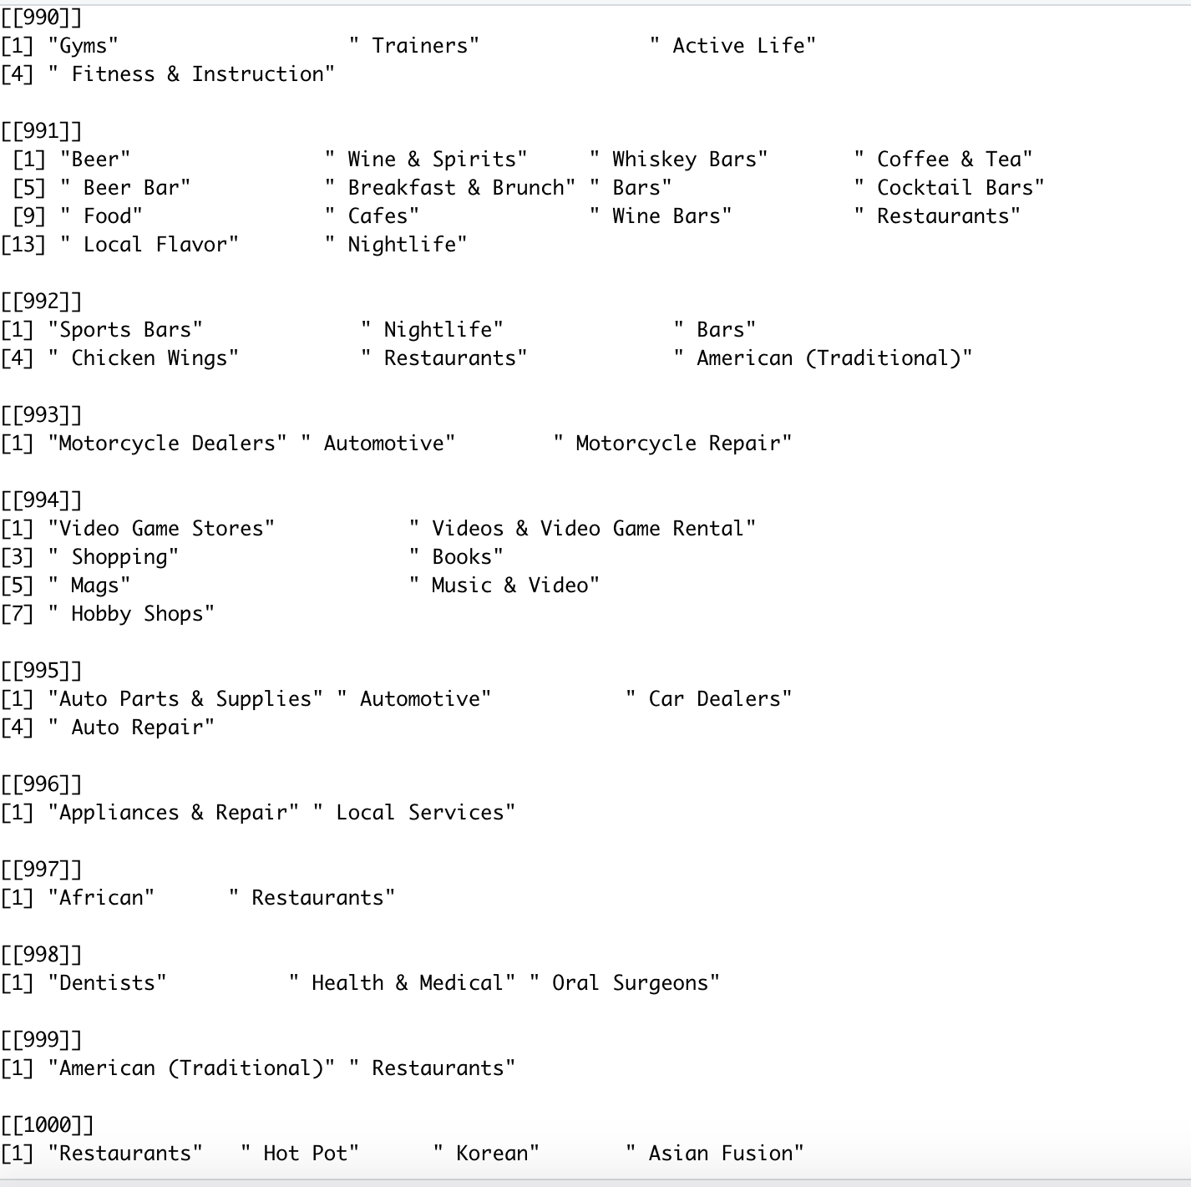
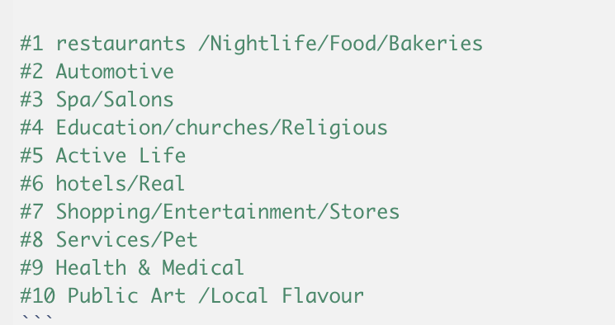
Data Cleaning
We found the NA values in each column and deleted those rows, thereby getting a new dataframe
In this new dataframe, the categories column consists of many sub-categories.
We split the categories and see that since there are 1000 comma -seperated values which maybe
similar to each other but differ by name hence, we cannot implement one hot encoding.
Then we grouped these 1000 comma-separated values in to 10 major categories.

Slide 6
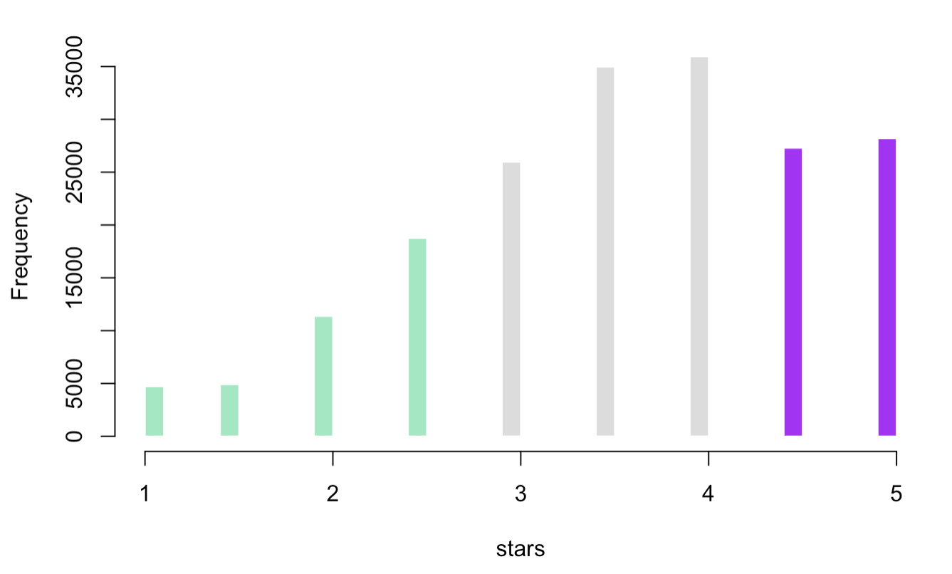
Normality Test
The above graph shows that Star Ratings are not Normally distributed as anticipated. The normal distribution curve is slightly Left-Skewed. And most of the ratings lie between 3 to 4.5

Slide 7
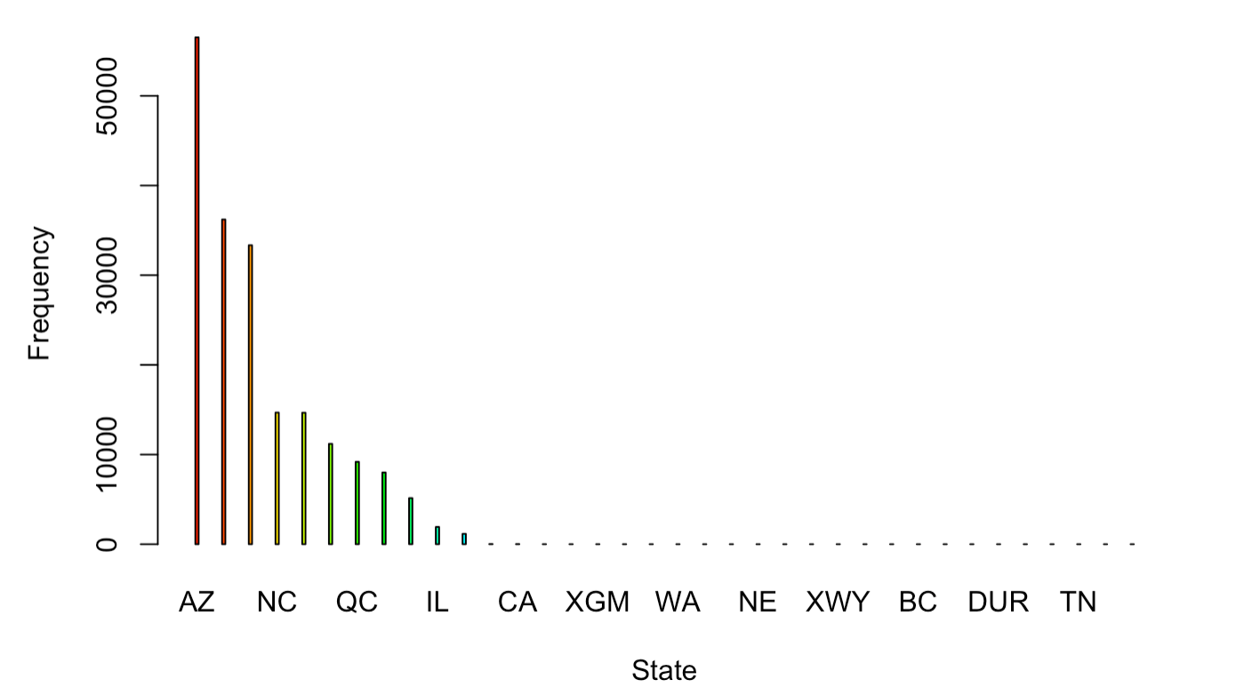
Exploratory Data Analysis (EDA)- STATE
The EDA on the States shows that Yelp is most prominent in the state of Arizona.

Slide 8
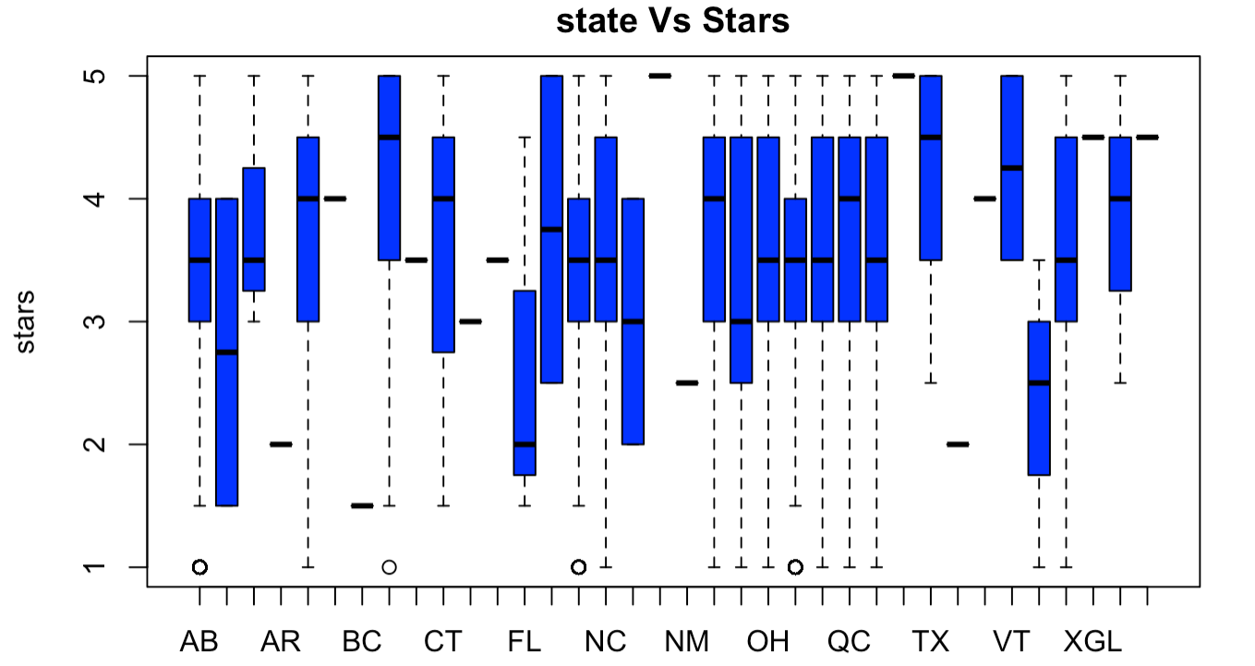
Graphical Representation
We can conclude that the Average star rating ranges from 3 to 4.5

Slide 9
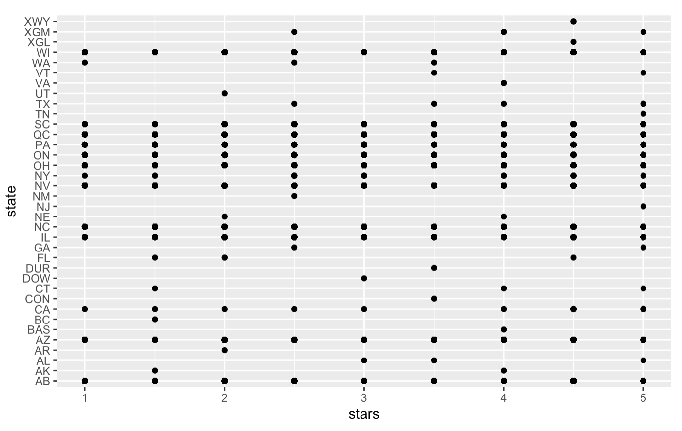
Graphical Representation
In some states like Florida, Texas , New Mexico there is nearly no data of star ratings which may suggest that- either Yelp is not well established in these states or the Advertisement strategies are not appropriate in these markets or there is some strong competitor in these states.

Slide 10
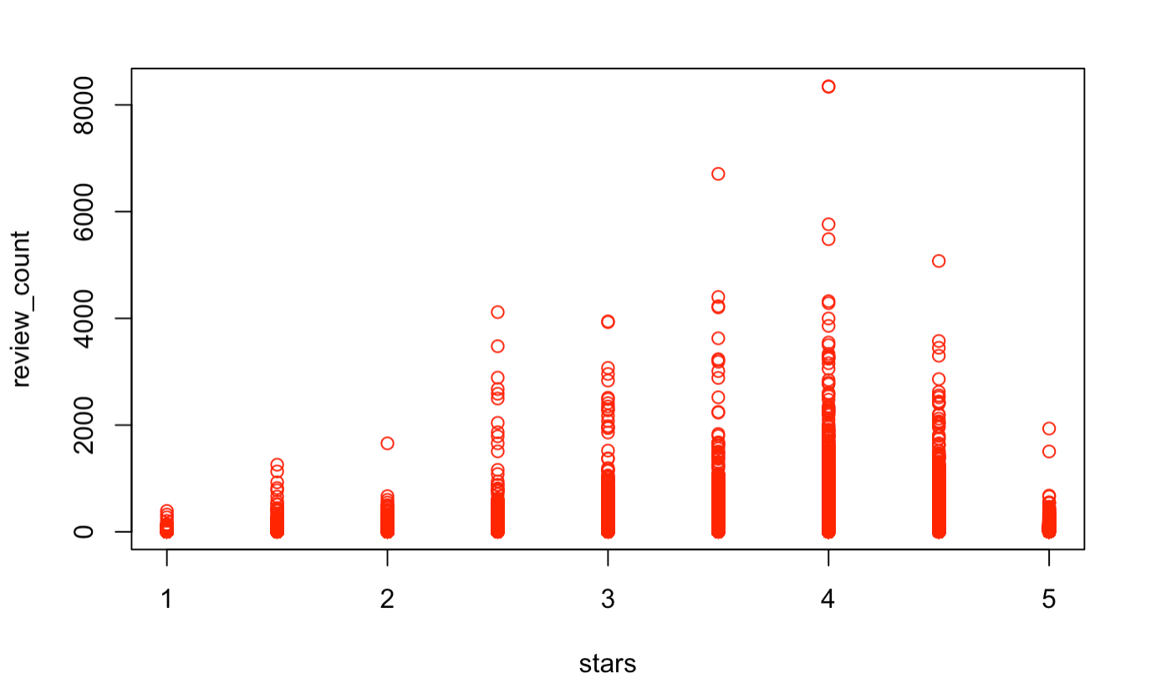
Graphical Representation- Stars vs Review Count
It can be concluded that for high number of review counts the average ratings is 4.

Slide 11
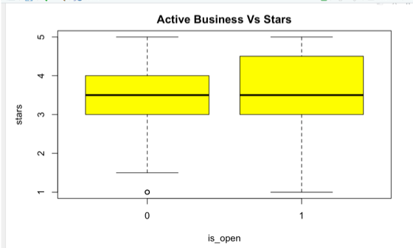
Graphical Representation- Active Business vs Stars
On looking at the Box plot between Star Ratings and Active Business we can conclude that there is no direct relationship between Star Ratings and the discontinuation of a particular business as even after achieving higher ratings some businesses have been discontinued. There may be other factors like relocation, labor scarcity, increased state taxes, demand of business, automation of services, which may have contributed in the shut down.

Slide 12
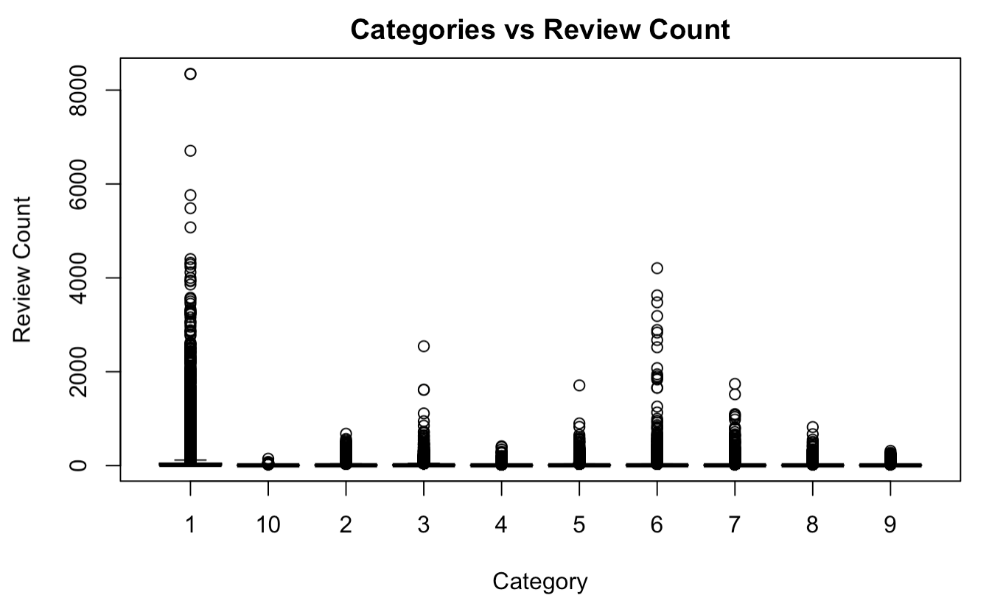
Graphical Representation
According to the dataset, the business which has received the highest number of reviews is Restaurant business, which may suggest that it is the most popular and established Yelp business. Yelp still have a lot of scope to improve it’s other businesses while maintaining its monopoly in Restaurant business as well.

Slide 13
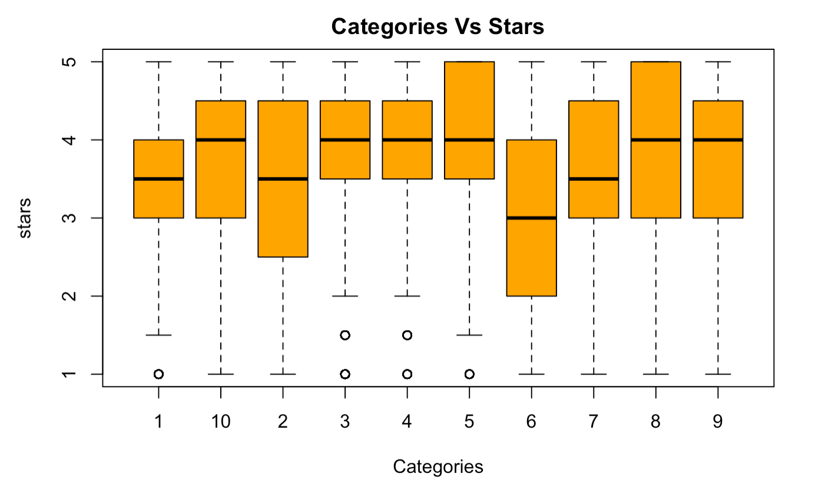
Graphical Representation
From our Previous analysis we concluded that the highest reviewed Yelp business is Restaurants but from the given boxplot we can conclude that the businesses which have achieved 5 star ratings are Pet Services and Gym & Active life.

Slide 14
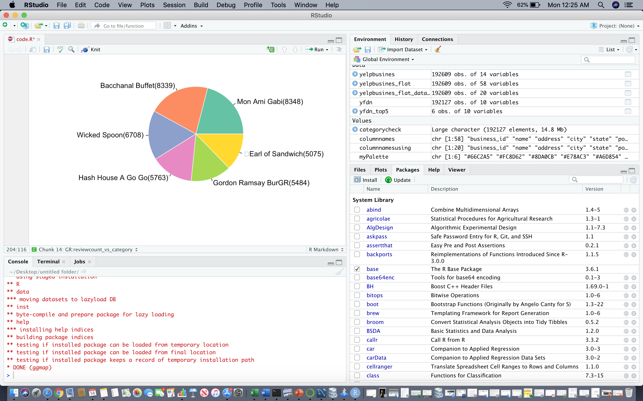
Top 5 rated business across us in terms of Review count
In terms of review counts, the top 5 businesses were evaluated, and all the 5 businesses are from the Restaurant Category with 5000+ review counts.

Slide 15
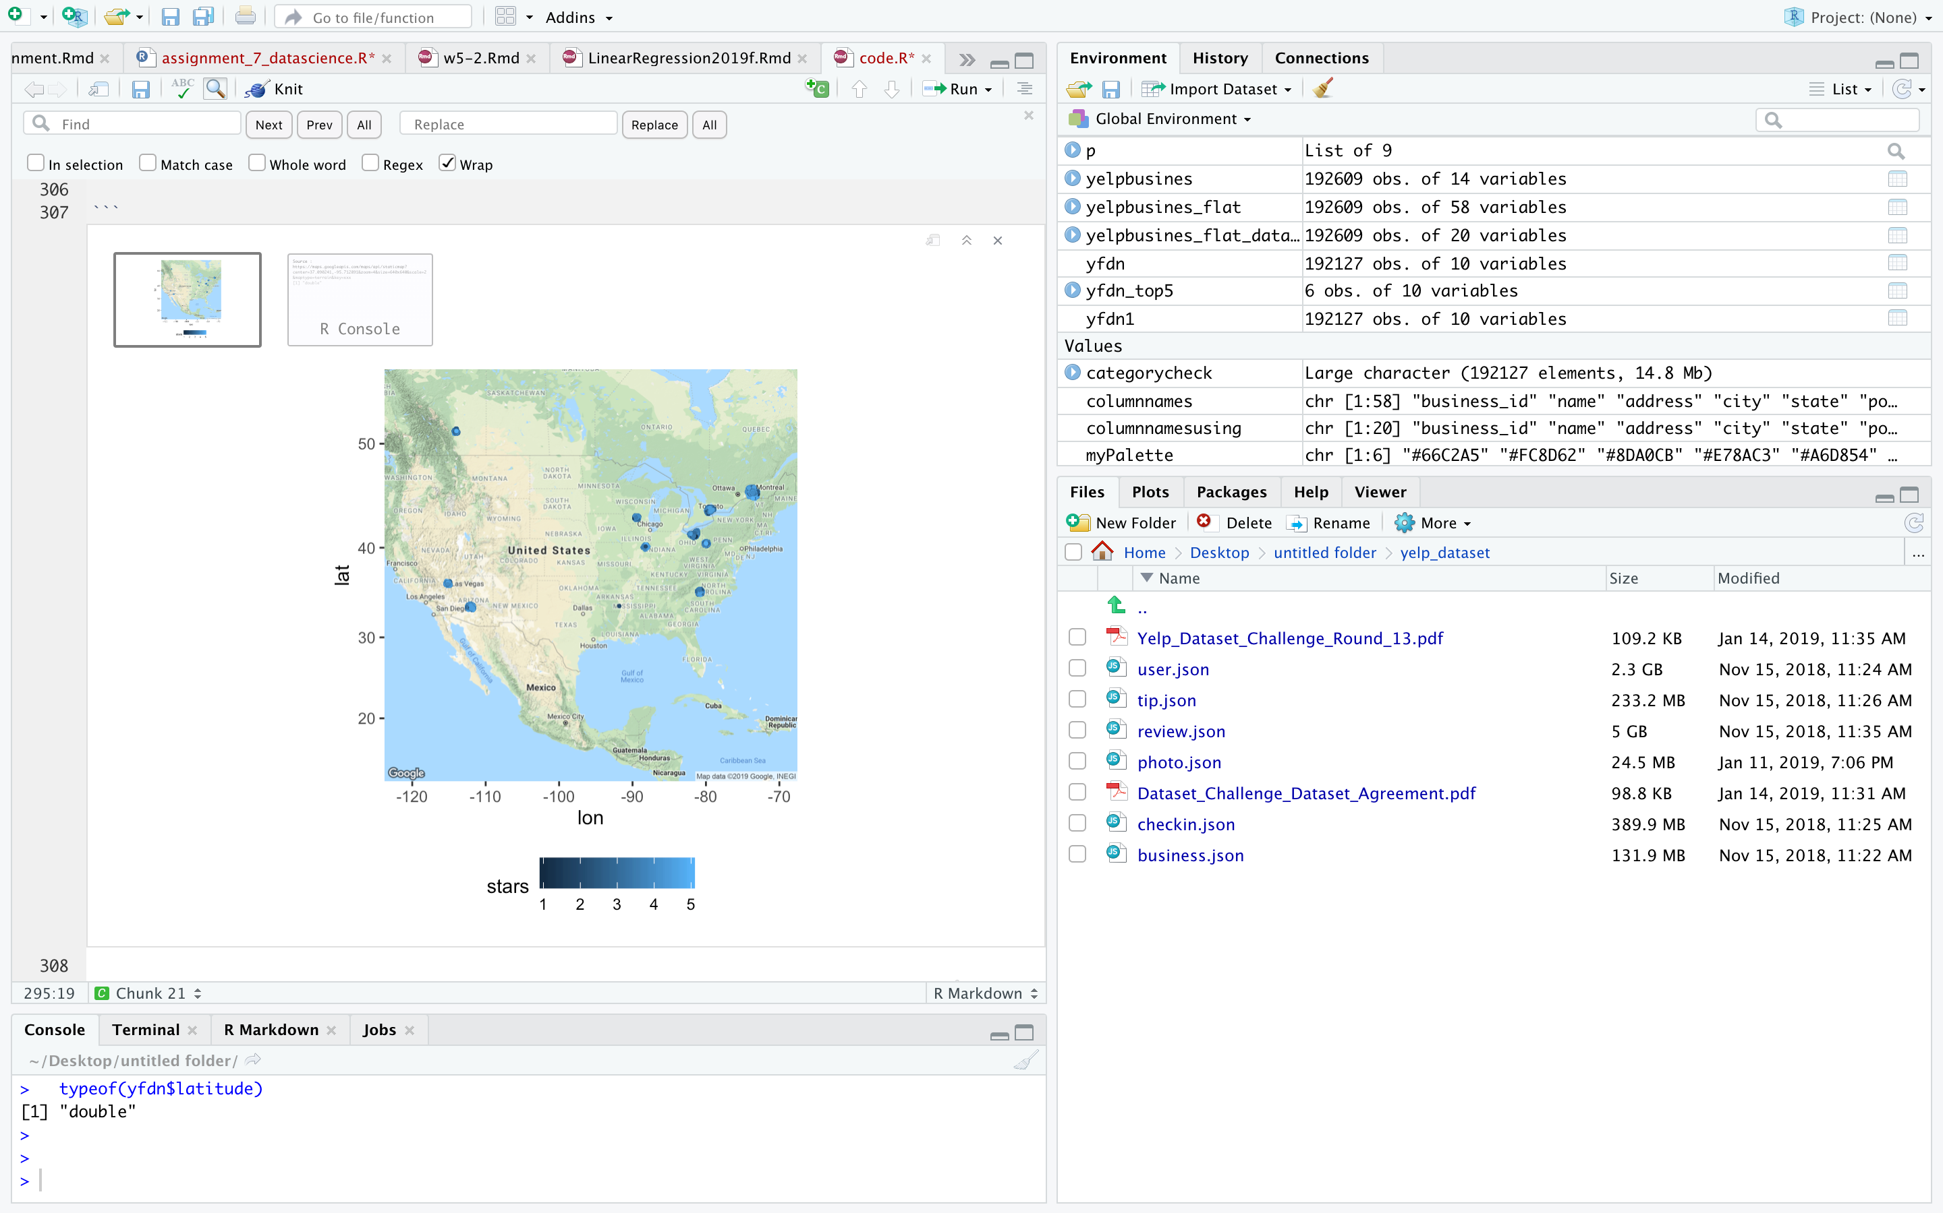
Locating business coordinates on google maps
Using the library ggmap and the latitudes and longitudes of the businesses, we have plotted the businesses on the US map with the help of google maps. The density of individual business in each state and their star ratings can be visualized by this map.

Slide 16
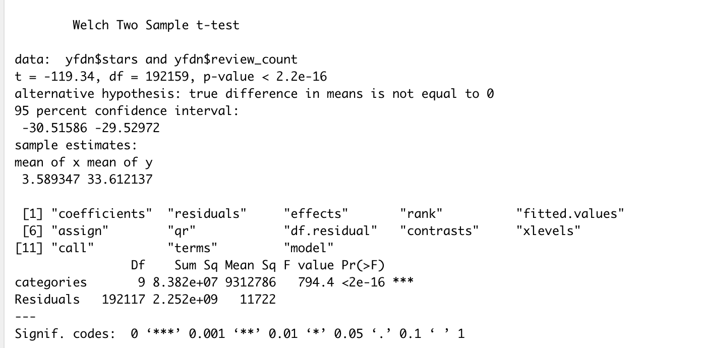
Statistical Test- T-test (Stars vs Review count)
Null Hypothesis : Review count for each ratings are equally distributed.
As the p-value is less than our significant value of 0.05 , we will reject null hypothesis.
CONCLUSION: The review counts across each star rating are different

Slide 17
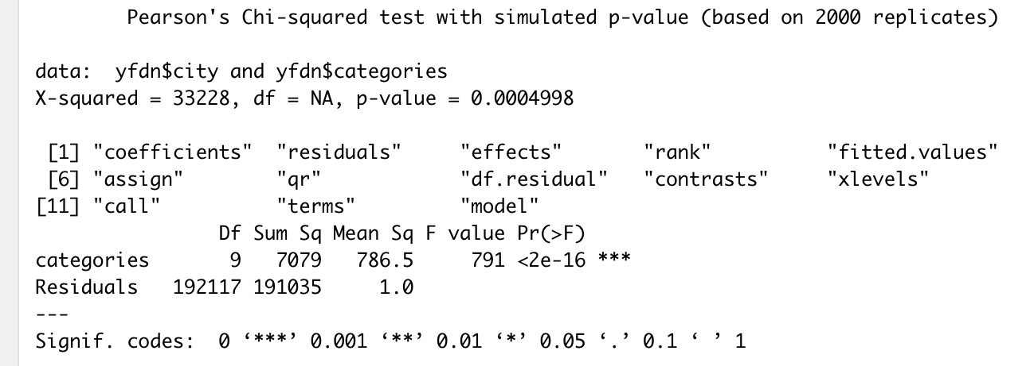
Statistical Test- Chi-Squared Test
Null Hypothesis : all the categories are equally distributed in each city
p value is low , so we will reject null hypothesis.
Conclusion: All the businesses are not equally distributed across cities

Slide 18
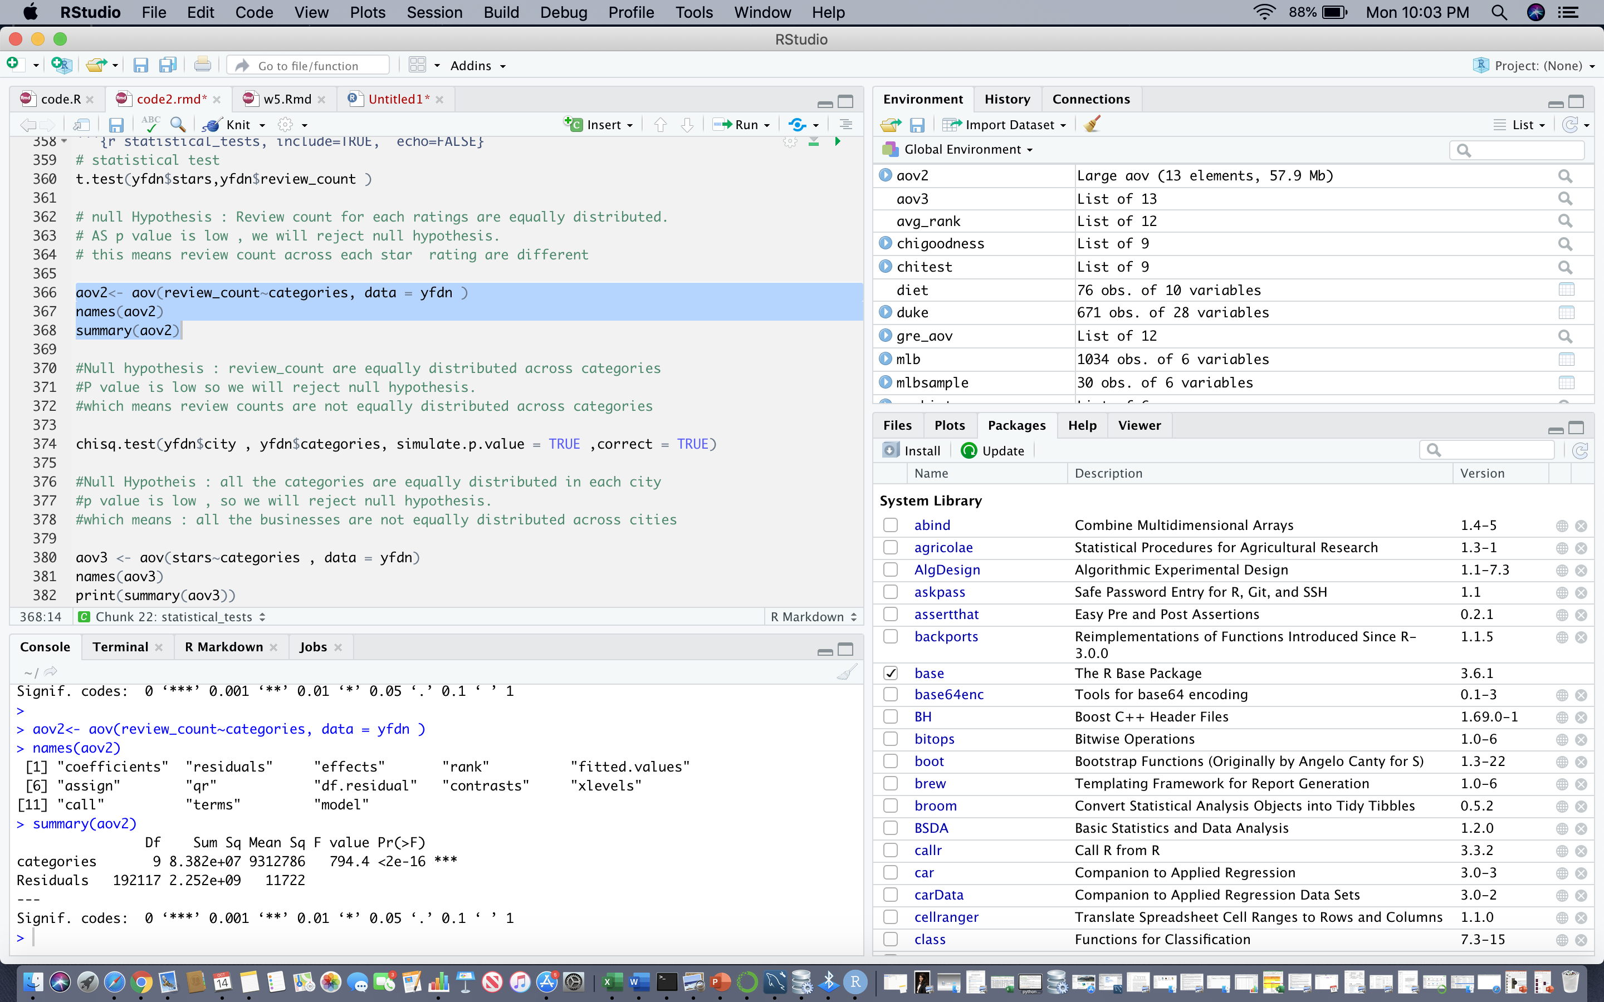
Statistical Test- Anova (Review count vs Categores)
Null hypothesis : Review count are equally distributed across categories.
P value is low so we will reject null hypothesis.
Conclusion: review counts are not equally distributed across categories

Slide 19
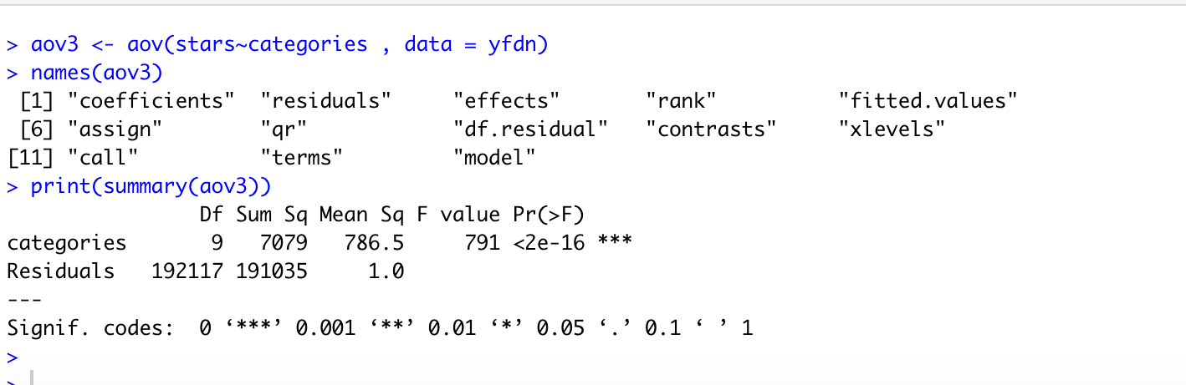
Statistical Test- Anova (Rating vs Categories)
Null hypothesis : star ratings are equally distributed across business categories
Since P value is low , we reject the null hypothesis
Conclusion: which means rating differs across categories

